Slide 1
UDDI PUBLISHER INTERFACE:

Slide 2
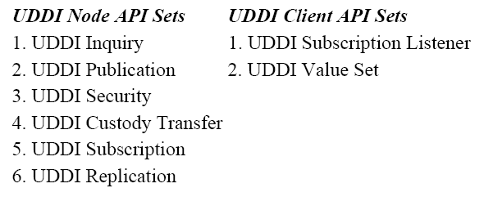
UDDI APIs

Slide 3
UDDI-Ctd.,
A registry is no use without some way to access it.
The UDDI standard version 2.0 specifies two interfaces for service consumers and service providers to interact with the registry.
Service consumers use Inquiry Interface to find a service, and service providers use Publisher Interface to list a service.
The core of the UDDI interfaces is the UDDI XML Schema definitions.
UDDI XML Schema define the fundamental UDDI data types through which all the information flows.

Slide 4
The Inquiry Interface:
The inquiry interface defines ten operations for searching the UDDI registry and retrieving details about specific registrations:
find_binding: Returns a list of web services that match a particular set of criteria based on the technical binding information.
find_business: Returns a list of business entities that match a particular set of criteria.

Slide 5
Inquiry Interface: Ctd.,
find_ltservice: Returns a list of web services that match a particular set of criteria.
find_tModel: Returns a list of tModels that match a particular set of criteria.
get_bindingDetail: Returns the complete registration information for a particular web service binding template.
get_businessDetail: Returns the registration information for a business entity, including all services that entity provides.

Slide 6
Inquiry Interface: Ctd.,
get_businessDetailExt: Returns the complete registration information for a business entity.
get_serviceDetail: Returns the complete registration information for a web service.
get_tModelDetail: Returns the complete registration information for a tModel.
find_relatedBusinesses: Discovers businesses that have been related via the uddi-org:relationships model.

Slide 7
The Publisher Interface:
The Publisher interface defines sixteen operations for a service provider managing its entries in the UDDI registry:
get_authToken: Retrieves an authorization token. All of the Publisher interface operations require that a valid authorization token be submitted with the request.
discard_authToken: Tells the UDDI registry to no longer accept a given authorization token. This step is equivalent to logging out of the system.
save_business: Creates or updates a business entity's information contained in the UDDI registry.
save_service: Creates or updates information about the web services that a business entity provides.

Slide 8
Publisher Interface Ctd.,
save_binding: Creates or updates the technical information about a web service's implementation.
save_tModel: Creates or updates the registration of abstract concepts managed by the UDDI registry.
delete_business: Removes the given business entities from the UDDI registry completely.
delete_service: Removes the given web services from the UDDI registry completely.
delete_binding: Removes the given web service technical details from the UDDI registry.
delete_tModel: Removes the specified tModels from the UDDI registry.

Slide 9
Publisher Interface CTd.,
get_registeredInfo: Returns a summary of everything the UDDI registry is currently keeping track of for the user, including all businesses, all services, and all tModels.
set_publisherAssertions: Manages all of the tracked relationship assertions associated with an individual publisher account.
add_publisherAssertions: Causes one or more publisherAssertions to be added to an individual publisher's assertion collection.
delete_publisherAssertions: Causes one or more publisherAssertion elements to be removed from a publisher's assertion collection.

Slide 10
Publisher Interface Ctd.,
get_assertionStatusReport: Provides administrative support for determining the status of current and outstanding publisher assertions that involve any of the business registrations managed by the individual publisher account.
get_publisherAssertions: Obtains the full set of publisher assertions that is associated with an individual publisher account.

